Slide 1
Surface Crack Classification – NEU Dataset

Slide 2
The Data
The NEU Metal Surface Defects Dataset from Kaggle was used.
https://www.kaggle.com/datasets/fantacher/neu-metal-surface-defects-data
This data contains 1800 grayscale images (200x200 pixels) of manufacturing defects on rolled steel plate.
There are 300 images of each of the six types of defects. Defect morphologies include:
Crazing
Inclusions
Patches
Rolled in Scale
Scratches
Pitting

Slide 3
The Data – Defects Overview
Crazing – Network of fine cracks resulting from a weakened grain boundary.
Inclusions – Foreign material (oxides or sulfides) that formed in the molten slag.
Patches – When “patches” of loose metal are rolled into the strip.
Rolled in Scale – Mill scale rolled into the slab.
Scratches – Resulting from build up on mechanical parts (rollers).
Pitting – Caused by worn mills or high milling temperature.

Slide 4
Application of Classifier
A high accuracy classification algorithm implemented in real time serves two purposes:
The state of the rolled steel plate will indicate if it is viable for the market.
Many of the damage morphologies provide insight into the state of the rollers and the overall manufacturing process. Knowledge of which particular damage is occur will be a starting point of what process remediations are required.

Slide 5
A Very Baseline Classifier
Pixel intensities (PI) of each image of each class in the training set were wrangled. PIs were summed over the entire training set. The discrete result was a normalized and treated as a distribution of grayscale intensities for each class.
Classification was based on the mean squared error (MSE) between the normalized pixel intensity distribution of each image in the testing set and each of the class distributions.
The class which resulted in the lowest MSE with the image was set as the result of the classifier.

Slide 6
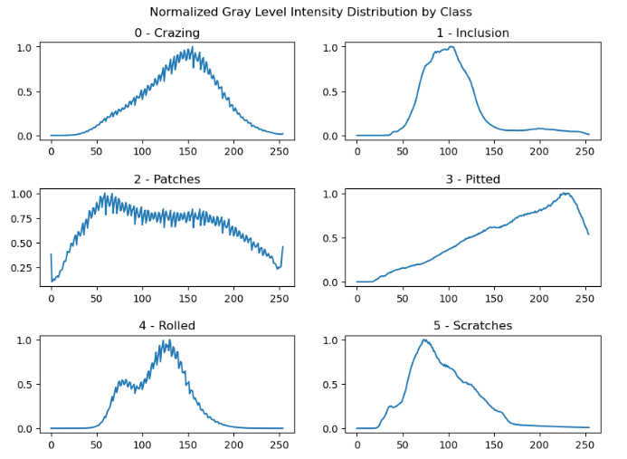
A Very Baseline Classifier: Class Distributions
Note the X-axis is the grayscale intensity value, and the y-axis is the frequency of occurrence over the entire data set.
For illustrative purposes only. The classifier was made using the test/train split of 33%

Slide 7
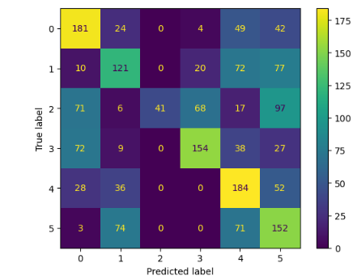

A Very Baseline Classifier (cont’d)
When the entire dataset was used for both testing and training the results were as follows:

Slide 8
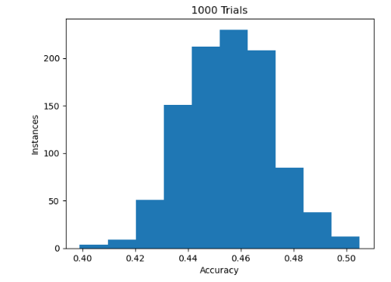
A Very Baseline Classifier (cont’d)
This experiment was conducted 1000 times using a 33% train/test split and the accuracy results plotted as a histogram.

Slide 9
A Very Baseline Classifier (cont’d)
The distribution of accuracy in the experiment is centered at the result from running the algorithm over the entire dataset.
This detour for the course project was driven by pure curiosity. The algorithm was both slow and too inaccurate to be used in a practical setting.
However, it is interesting to see that a 46% classification accuracy could be achieved based on contrast alone.

Slide 10
Neural Network - Experiment Design
Convolutional Neural Networks will be constructed incrementally to familiarize myself with the impact of each layer.
The number of convolutions, depth of convolutional layers, and optimizer type will be compared.
1530 images are used for training and the remaining 230 used for testing.

Slide 11
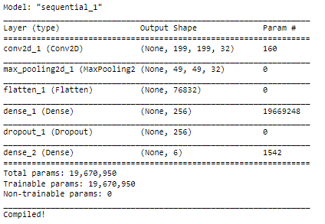
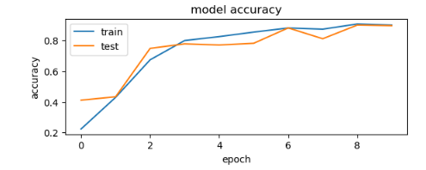
Neural Network 1 – Base Case
This model was compiled with the rmsprop optimizer. It achieved a 90% validation and training accuracy after 10 epochs, and serves as the base case for the remaining neural networks.

Slide 12
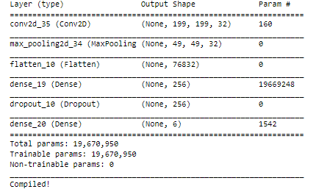
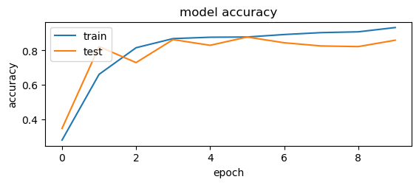
Neural Network 1 – Adam Optimizer Test
This model was compiled with the adam optimizer. It achieved a 93% validation and a 86% training accuracy after 10 epochs. The adam optimizer has overfit the training set compared to the rmsprop network. More on this in future directions

Slide 13
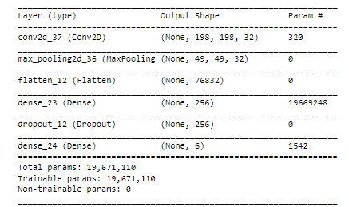
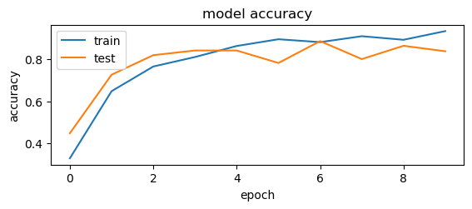
Neural Network 1 – Filter Size Test
This model architecture was identical to the base case save for the size of the filters in the convolutional layer. The filters here are (3,3) instead of (2,2). The training accuracy after 10 epochs was 0.933 and the validation accuracy was 0.837. The decreased performance may be resulting from pixel loss around the boundary.

Slide 14
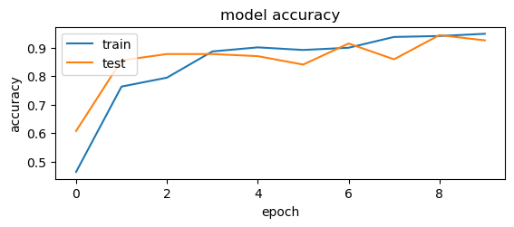
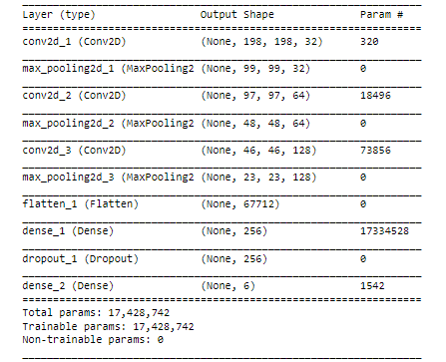
Neural Network 2 – Additional Convolutions
This model implemented 3 convolutional layers. It achieved a validation accuracy of 0.949 and a test accuracy of 0.926. Discussion continued on the next slide

Slide 15
Neural Network 2 (cont’d)
Despite having less parameters, this model outperformed the base case neural network.
The “kinks” in the validation accuracy leads to questioning of the Adam optimizers hyperparameters further studies treating the learning rate as a hyperparameter can be explored.

Slide 16
Conclusions
Simple, single convolution layer CNNs were able to achieve impressive (~90%) accuracy results on the NEU surface defects dataset.
The optimizer type had noticeable impact on model performance.
Increasing the number of convolutional layers, and the depth of these layers provided substantial (~3%) validation accuracy improvements.
Relation between layer types makes developing functional CNNs a delicate task.

Slide 17
Limitations of Analysis
This dataset contained no examples of undamaged steel plate. The classifier will then force any image passed to it into one of the damaged classed.
For increased practicality a binary classification algorithm should be trained that distinguishes between damaged/undamaged plates. Only after the plate is labelled as damaged should the results of this project be applied.
The damage morphologies characterized by the NEU dataset are but a small sample of what is seen in the field.

Slide 18
Future Directions
Data augmentation should be implemented to get more out of the dataset.
This includes image processing such as magnification and rotation. Translation invariance of the images is expected.
Hyperparameters of the adam optimizer can be tuned to better fit each model.
The size of the pooling later can be varied as a hyperparameter.
Batch normalization can be implemented. This is expected to increase the stability of the algorithm.

Slide 19
References
https://www.ispatguru.com/metallurgical-processes-and-defects-in-steel-products/
https://www.intel.com/content/www/us/en/developer/articles/technical/use-machine-learning-to-detect-defects-on-the-steel-surface.html
https://www.steeljrv.com/64-pictures-of-common-defects-in-strip-steel.html#Rolled-inscale

